Slide 1

Modeling the Effect of Natural Disasters (proxy variable of hospital resources) on the Spread of COVID-19

Slide 2
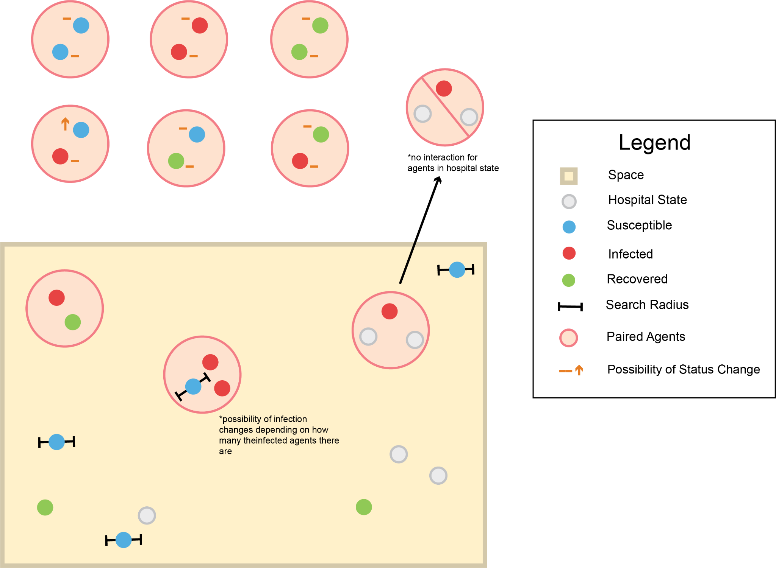
General Process Diagram

Slide 3
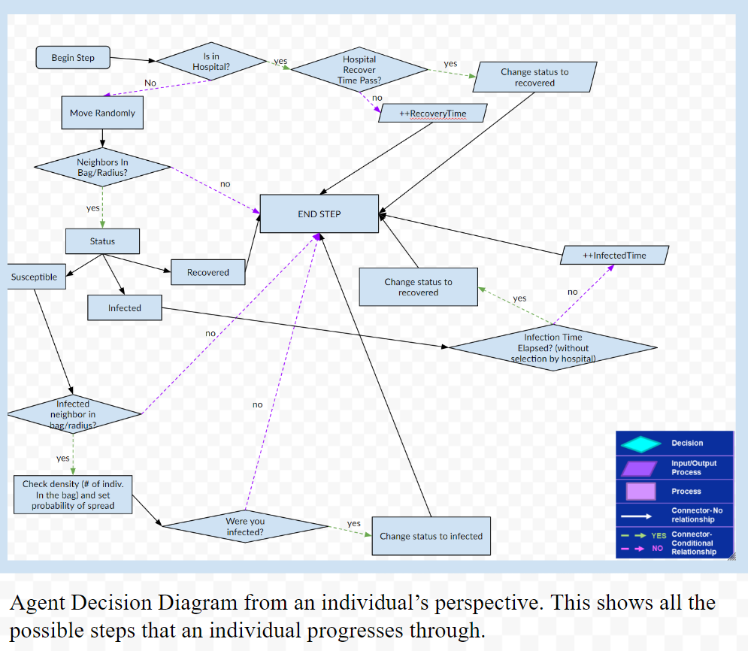
Agent Decision Diagram

Slide 4
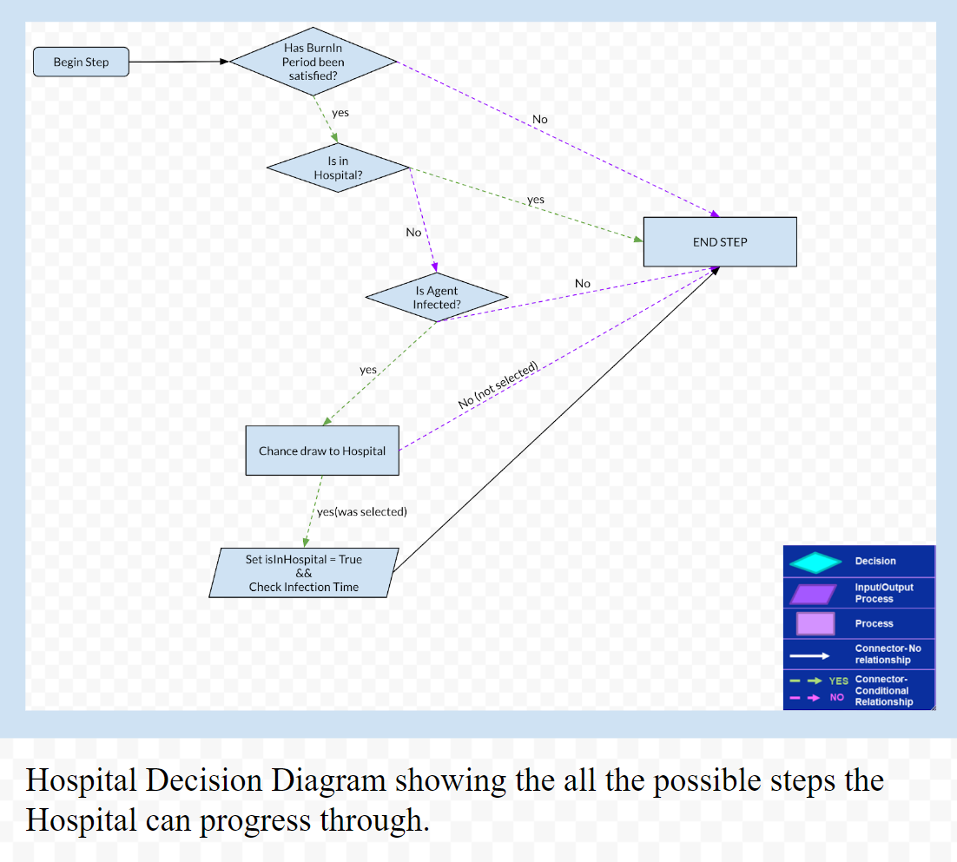
Hospital Decision Diagram

Slide 5
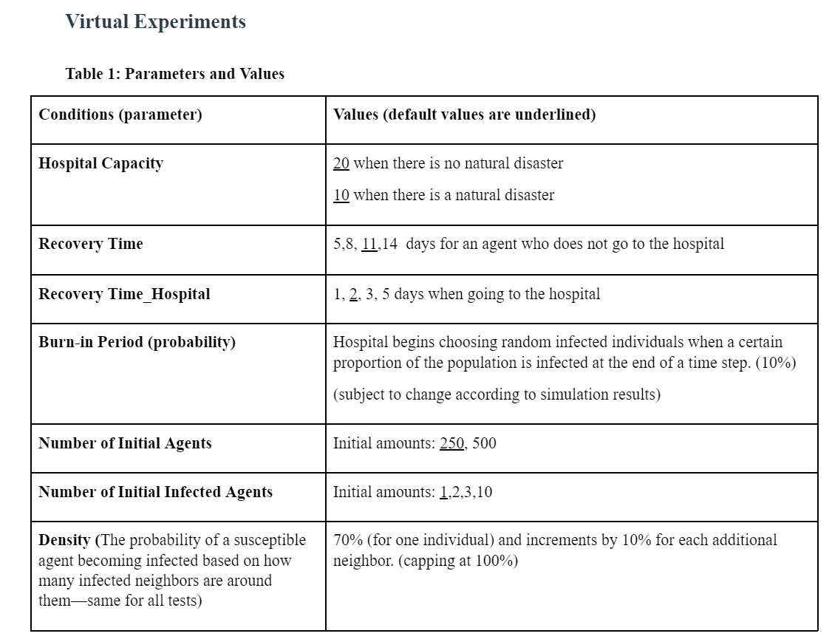
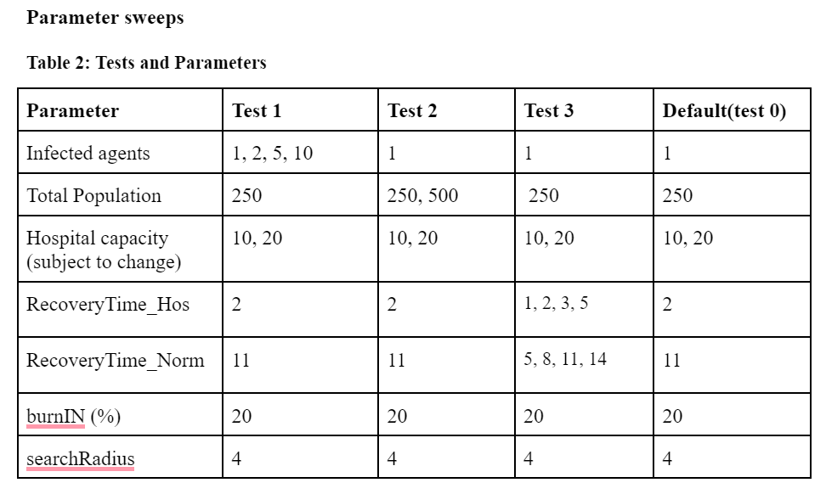
Available Parameters and Sweeps

Slide 6
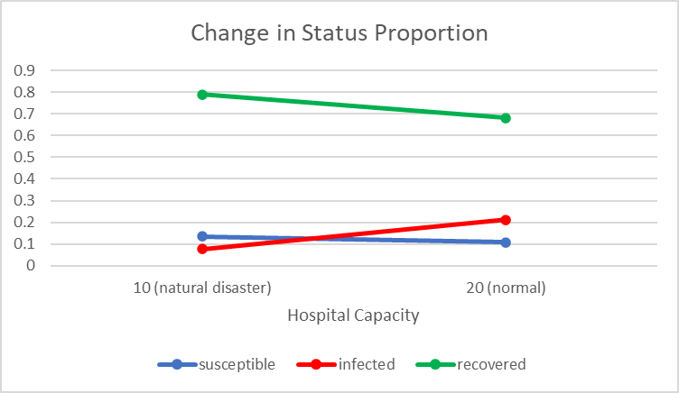
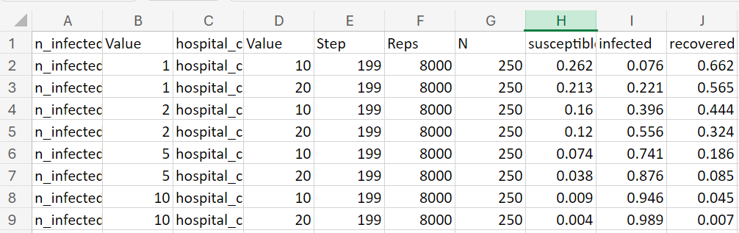
Further Explanation of Test 1
Hypothesis: Increasing the number of initially infected agents accelerates the timeframe for the epidemiological patterns (of COVID-19 spread ~ exceeding the effect of natural disasters) that occur. Therefore, there is a decreased change in status proportions across natural disaster and no natural disaster condition.
Baseline (test 0): Data:

Slide 7
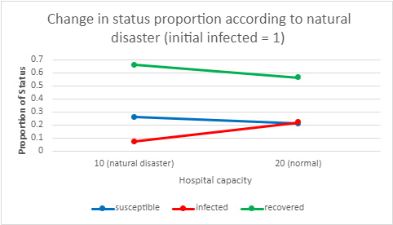
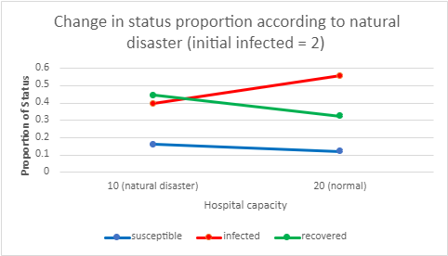
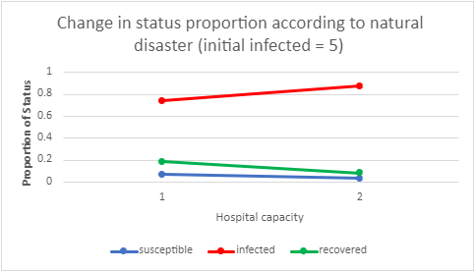
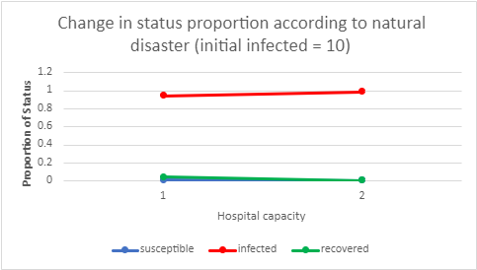
Notes:
Bug in code where some infected agents are switching to recovered; but we can see the exacerbated rate of spread to where hospitals and natural recovery cannot keep up

Slide 8
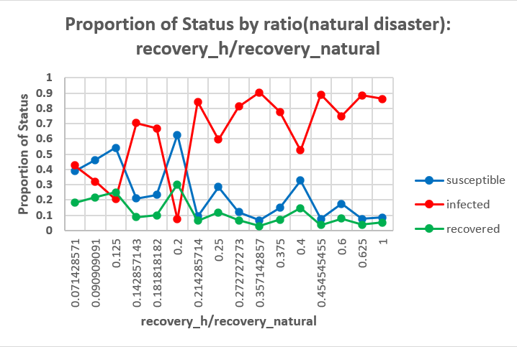
Additional

Slide 9
Conclusions
Conclusion: major takeaways from the model
Effects of Natural Disasters, through decreased resources, on epidemiological spread is significant
An initial infected population of 1 best models the spread of COVID in real life
Addressing issues with how agents move within the environment and how infection calculated can help us better model how COVID actually spreads

